Slide 1


BSc Hons Computer Game Design and Development GDV4000 Introduction to Games Industry Practice
Game Development Process – The Game Design Document

Slide 2
Topics we’ll be looking at
A Brief Recap
Organisation of the Development Team
Creating a Game Design Document

Slide 3
Recap
• Overview of the Development Process…
Pre-Release
Initial idea / concept
Design
Review
Prototype
Funding secured
The Pitch
Development/ Prototyping
(“Release To Manufacture”)
RTM /
Gold Master
Milestone
Testing
Crunch
Review / Design Eval
Pending deadline

Slide 4
Recap
Overview of the Game Concept
The concept stage outlines the following aspects of the game (and forms the basis of the Pitch document).
Introduction
Sell the game – keep it to a short and succinct statement that sums up your game, including the genre.
Background
Expand on any previous IP if available – can help to sell the game idea.
Gameplay Narrative
Describe how the player plays through the game – emphasise key actions and challenges.
Key Features / pillars of the game
What makes the game special? What experience do you want your players to have? What is the ‘soul’ of the game? This can also form part of your Unique Selling Points.
Target Platforms
The intended platforms you want to implement the game on.

Slide 5
Organisation of the Development Team
Senior Management
(Strategy / Development)
Managing Director
Publisher
Director of Development
Technical Director
Art Director
Project-Level Team
Support
Project Director / Lead
Lead (Senior) Programmer
Lead (Senior) Designer
Creative Lead
QA and Testing
Engine Programmers
Concept Artists
Marketing
Designers
Texture Artists
Legal
AI Programmers
Level designers
2D Artists
Physics Programmers
3D Modellers
Sub-contracting
GPU Programmers
Animators
Tools / Middleware Programmers
Sound Engineers
Gameplay Programmers
Composers
Engine Scripting

Slide 6

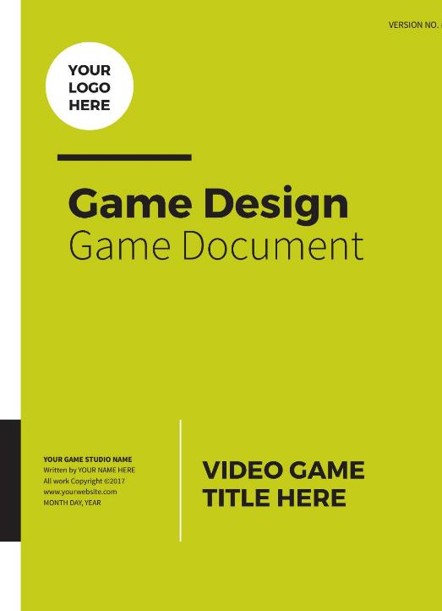
Google: GDD & TDD
Google: Game Design Document Example
You’ll get MANY MANY examples
In general each one has a particular bias to a particular type of game or a particular teams approach to development
Probably not a good idea to follow any such list slavishly
EVEN MINE
Add, remove, combine, takeaway as your project requires

Slide 7
Game Design Document & Technical Design Document
Your GDD describes “What the game is” – breaking down your ideas as described in the elevator pitch and your game concept.
A Technical Design Document (TDD) describes “How the game is accomplished” – What tools will be used, how programming turns the game into reality
Your ‘Game Bible’ which details everything about the game
They are ‘live’ documents -You will have to update both of them over the development of the game
GDD should be understandable to anyone reading it, especially new people on your team (Designer; Artist; Programmer, etc). TDD should be understandable to people with a technical background (Programmer; Engineer)

Slide 8
They are ‘live’ Documents
You will have to update both of them over time!
Also DON’T wipe yourself out trying to implement something that is no longer required!
Change the GDD!

Slide 9
Creating a Game Design Document
We can look at our design documentation an having three main aims:
Designers express their vision of the game
Producers express a plan for how the game will be implemented
The design serves as a document from which the artists and programmers can create the final product.
This final point is very important. A good design document should be communicating everything that the development team needs to perform their role (what they need to do!). It should also give each team/individual a good understanding of how their contribution fits into the bigger picture.

Slide 10
Creating a Game Design Document
What is in a Design Document?
The design documentation of a game spans everything from the concept to the production planning. The main documents are:
Initial Concept/ Proposal (internal)
The Pitch Document
Game Design (What is in the game – written from the perspective of the player)
Technical Specification (how things are implemented – system view)
Production Documentation (project planning/ schedules)
In each case, it is important to follow guidelines, as design documents can vary in length and clarity, depending on the developer and the game.
Guidelines help to ensure consistency and make the documentation easier to follow, with less uncertainty during implementation.

Slide 11
Creating a Game Design Document
The Game Design Document
The purpose of the game design document is to set out exactly what is in the game. This can also be referred to as the functional design.
It is written from the player’s perspective, in the context of the game’s environment.
It is not a pitch document. Its job is not to sell the game, but to elaborate on each aspect of the game, demonstrating how the intended game will fulfil the original vision/ game pillars.
The Game Design can consist of the following sections:
Story (if relevant)
Game Mechanics
Internal Economy
User Interface
Art + Video
Sound + Music
Level Requirements

Slide 12
Creating the Game Design Document
Story
This section is an opportunity to expand on the game’s narrative and background lore. It may not be appropriate or relevant for every game (Space Invaders), but an open world adventure, or an RPG game will typically have some kind of backstory. There will be a synopsis of the game world, the characters and where the game story fits in. The following sub-sections can be included (depending on the type of game):
Back Story – The world, history, cultures, and key protagonists/ antagonists.
The plot played out by the game and where this fits into the world/ back story.
Descriptions of key locations (reference point for subsequent level design)
Descriptions of the characters in the world (reference point for subsequent character art/ design). This can include the history of cultures, clans etc.
Outline of dialogue, text and cut-scene requirements to help guide the development of the schedule. Cut scenes for key points in the story should be highlighted. Also, the types of interaction and dialogue the characters will exhibit can be identified. A trader will interact differently to a warrior or a wizard. Doing this helps to create a clearer picture for subsequent development. Note: This should also include “background” dialogue.

Slide 13
Creating a Game Design Document
Gameplay
Game mechanics refer to the actions/ mechanisms that drive the game forward. Prior to describing the mechanics of the game, you should provide a brief synopsis of two important aspects (which underpin the core pillars of the game, established at the concept stage, and are in turn underpinned by the game mechanics and other design elements). These are:
Gameplay
Flow

Slide 14
Creating a Game Design Document
Gameplay
Gameplay refers to the interaction between the player and the game. This is an emergent property, supported by the core game mechanics (explored later in the design). In this section you can document:
The type(s) of gameplay your game will be based on (broad categories)
Linear – Complete tasks in a set order as you progress through the game world, completing set goals.
Non-Linear – Complete tasks in different orders to achieve a goal (open world games).
Multiplayer Symmetric – Multiple players, each with similar gameplay.
Multiplayer Asymmetric – Multiple players but with sub-sets having different gameplay.
Multiplayer Cooperative – Multiple players that work together.
Provide a synopsis describing how the players interact with the game, and how the feedback from the game to the player works, how it responds to the player. This section dives deeper into the core pillars established at the concept stage, but now you are linking them, at a high level, to the mechanics that will eventually drive it.
Example – You are implementing cooperative play, so you need to describe how each team member’s skills are asymmetrical, providing different roles, and how each role is challenged and rewarded.

Slide 15
Creating a Game Design Document
Flow
Closely tied to the mechanics in the concept of flow. Flow reflects the state of immersion/ focus the player experiences in the game. This is not just related to the mechanics, but is influenced by every aspect of the design.
In this section, describe what you want to achieve in terms of immersion. Outline key points/ guidelines that will underpin and maintain your intended flow within the game. How you do this can be expanded and elaborated upon in each subsequent section of the design, referencing back to your original intent.
How will you put the player “in the zone”?

Slide 16
Creating a Game Design Document
Flow
Some background – From the field of psychology there are 9 key principles that underpin flow (the term flow was coined by Mihaly Csikszentmihalyi)…
Intense and focused concentration on the present moment
Merging of action and awareness
A loss of reflective self-consciousness
A sense of personal control or agency over the situation or activity
A distortion of temporal experience, one’s subjective experience of time is altered
Experience of the activity as intrinsically rewarding, also referred to as autotelic experience
Immediate feedback
Feeling that you have the potential to succeed
Feeling so engrossed in the experience, that other needs become negligible

Slide 17
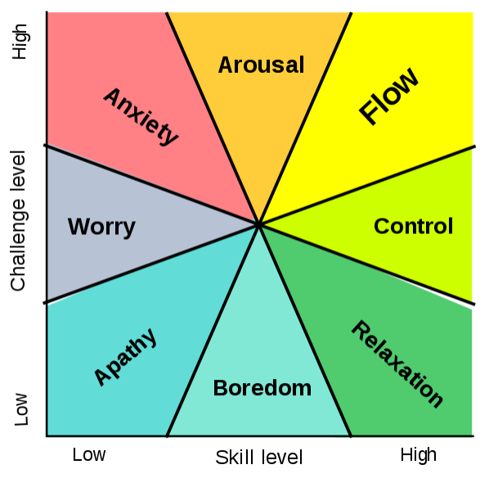
Creating a Game Design Document
Flow
Where flow sits in relation of skill/ challenge…
Flow
Challenge
Skill
from Csikszentmihalyi's flow model
Try to keep your player in this region

Slide 18
Creating a Game Design Document
Game Mechanics
Mechanics vs. Rules
Games have rules:
‘A game is a type of play activity, conducted in the context of a pretended reality, in which the participants try to achieve at least one arbitrary, nontrivial goal by acting in accordance with rules.’
Fundamentals of Games Design: Ernest Adams.
‘A game is a system in which players engage in artificial conflict, defined by rules, that results in a quantifiable outcome.’
Rules of Play: Katie Salen Tekinbras and Eric Zimmerman.
‘To play a game is to attempt to achieve a specific state of affairs, using only means permitted by rules, where the rules prohibit use of more efficient in favour of less efficient means, and where the rules are accepted just because they make possible such activity.’
The Grasshopper: Bernard Suits (Suits was writing in 1978 and does not consider video games, or table-top role-playing games).
Consider the game of golf…
The objective of the game is to get the ball in the hole in as few moves as possible. The most efficient means of doing this would be to pick up the ball and drop it in the hole. The rules create a situation where this is not permitted and adds a complication that a golf club must be used.

Slide 19
Creating a Game Design Document
Game Mechanics
Mechanics vs. Rules
Games have rules:
‘A game is a type of play activity, conducted in the context of a pretended reality, in which the participants try to achieve at least one arbitrary, nontrivial goal by acting in accordance with rules.’
Fundamentals of Games Design: Ernest Adams.
‘A game is a system in which players engage in artificial conflict, defined by rules, that results in a quantifiable outcome.’
Rules of Play: Katie Salen Tekinbras and Eric Zimmerman.
‘To play a game is to attempt to achieve a specific state of affairs, using only means permitted by rules, where the rules prohibit use of more efficient in favour of less efficient means, and where the rules are accepted just because they make possible such activity.’
The Grasshopper: Bernard Suits (Suits was writing in 1978 and does not consider video games, or table-top role-playing games).
Consider the game of golf…
The objective of the game is to get the ball in the hole in as few moves as possible. The most efficient means of doing this would be to pick up the ball and drop it in the hole. The rules create a situation where this is not permitted and adds a complication that a golf club must be used.

Slide 20
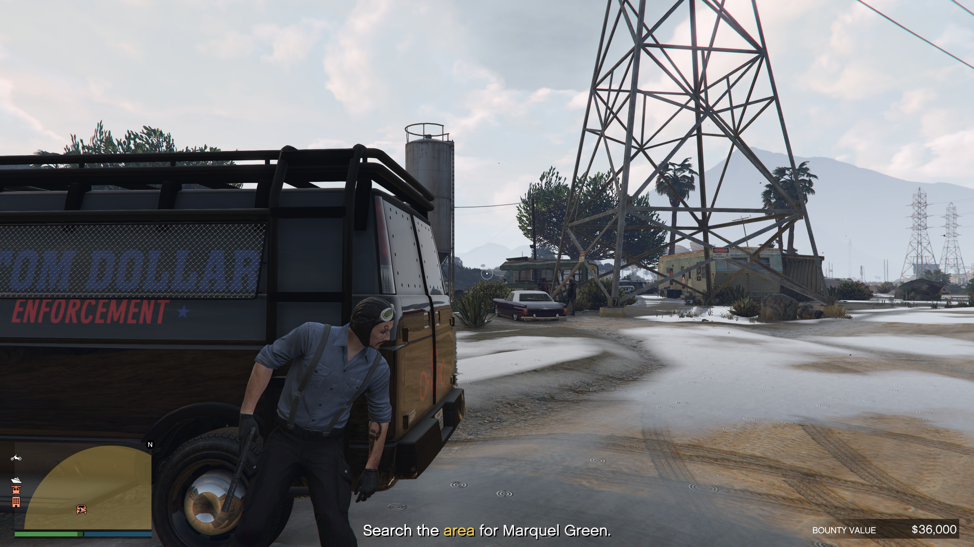
Creating a Game Design Document
Primary and Secondary Core Mechanics
Definition refined by Sicart(2008)
Primary
Directly applied to solving challenges
Secondary
Ease the players interaction with the game.
Available occasionally or used in combination with other mechanics.
Cannot be used alone to solve challenges.
Can just taking cover in a shooter defeat your enemies? It might to keep you alive but eventually you need to leave cover and take offensive action.
Core
"… the essential play activity players perform again and again in a game (...) however, in many games, the core mechanic is a compound activity composed of a suite of actions" (Salen Tekinbas and Zimmerman, 2004, p. 316).
"… the possible or preferred or encouraged means with which the player can interact with game elements " (Järvinen 2008, p. 255)
Games are classified into genres based on their gameplay.
Gameplay is generated by game mechanics.

Slide 21
Creating a Game Design Document
Internal Economy
Many games have a form of ‘Internal Economy’. The depth and complexity of these economies can depend on the game genre. RPGs and strategy games will have different complex economies (trading, crafting, mining, construction, XP…) that interact with each other, FPS and platform games may have more straightforward economies (Ammo, Health, Coins…).
When talking about your Internal Economies, expressing them in a table as a list of items with their value/ worth in the game economy and how they impact the player (positive/ negative).
Item Name | Item Type | Damage | Weight | Buy (Gold) | Sell (Gold) | Player Effect
Frostblade | Weapon | 25 | 10 | 2000 | 1500 | +15% Frost Damage +10% Frost Resistance -5% Fire Resistance
This example not only contains an example of the kind of ‘colour’ that we would expect in the GDD (lore, such as the in-world name of the weapon, it’s value and effects), but also information that would be featured in the TDD (values such as the weight, damage, the weapon type…) and would be needed by the developers programming the game.

Slide 22
Creating a Game Design Document
Types of Game Mechanic
3. Progression Mechanism
Often dictated by levels
Fight to end of level, defeat boss.
Find keycard, open door.
Tiers of races / heats / predrawn pools.
According to Adams & Dormans (2012) there are 5 types:
1. Physics
Generally, how things move/interact.
Hyperreal fluid simulations, cartoon physics, legal card placement in Solitaire.
4. Tactical Manoeuvring
Placement of units / selection of weapons etc (Rampart, StarCraft, Chess, Civilisation)
Timing/Rhythm
The pace at which things change within the game, e.g., waves of NPCs etc,
2. Internal Economy
Transactions within the game, items collected, consumed, traded etc.
Sometimes resources (money, ammunition…)
Abstractions (health, popularity, ability, skill, points/levels…)
5. Social Interaction
More recent, originally limited to:
Prohibiting collusion (Don’t give away your next move).
Hiding information (covering your cards, Battleships etc.)

Slide 23
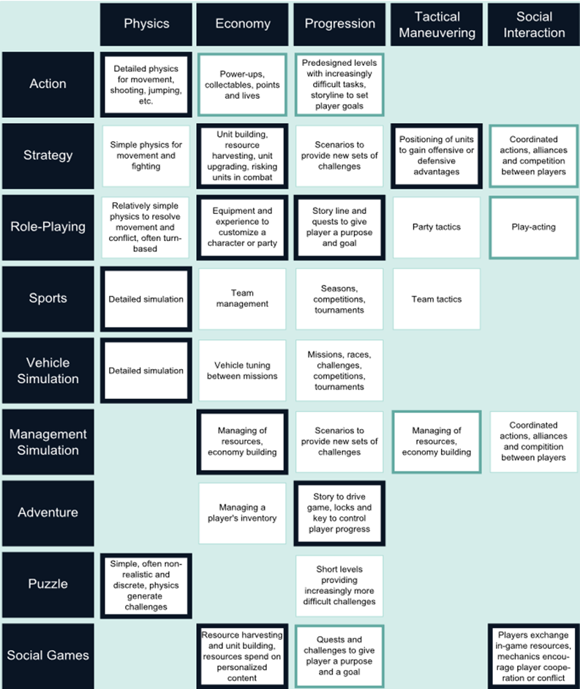
Game genres and mechanics
This table is adapted from Adams & Dormans (2012 p.8).
Line thickness denotes importance.
In the time since the authors created the table, elements such as Social Interaction have evolved.
Use this as a guide – The concepts we are discussing are not set in stone!
When discussing your Core (Primary/Secondary) and Non-Core mechanics, you should be able to explain, in the context of your game, why they are classified that way.

Slide 24
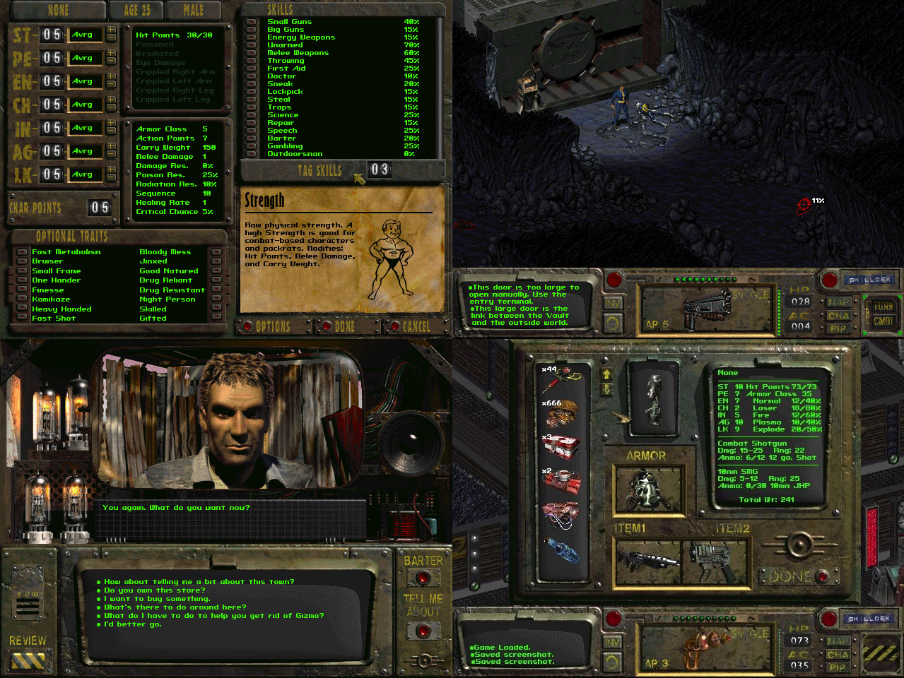
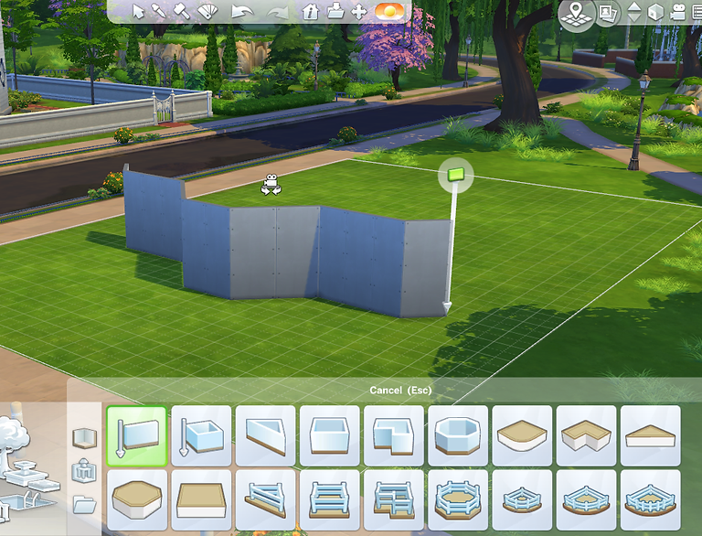
Creating a Game Design Document
User Interface
Describe/ illustrate all aspects of the game’s interface that the player interacts with.
What are the functional requirements of each screen and menu? Why do they exist and what do they do? Identify the essential elements that are shown to the player and the non-essential that can be configured or hidden.
Flowcharts (storyboards) showing how the different screens and menus are connected together and how the player navigates them.
Give a detailed description of all GUI/ HUD elements the player will interact with – Buttons/ navigation elements, textual elements (menu options), graphical elements and UI-based sound effects/ music. Type (font) design requirements can also be included here.
These are described separately from the UI functional requirements as there is a higher chance that they will change. When describing GUI elements, feel free to provide illustrations and mock-ups that could be a guideline to the artists, but give them room to adapt and change the design.
Fallout 2 – Black Isle Studios
The Sims 4 – Maxis

Slide 25
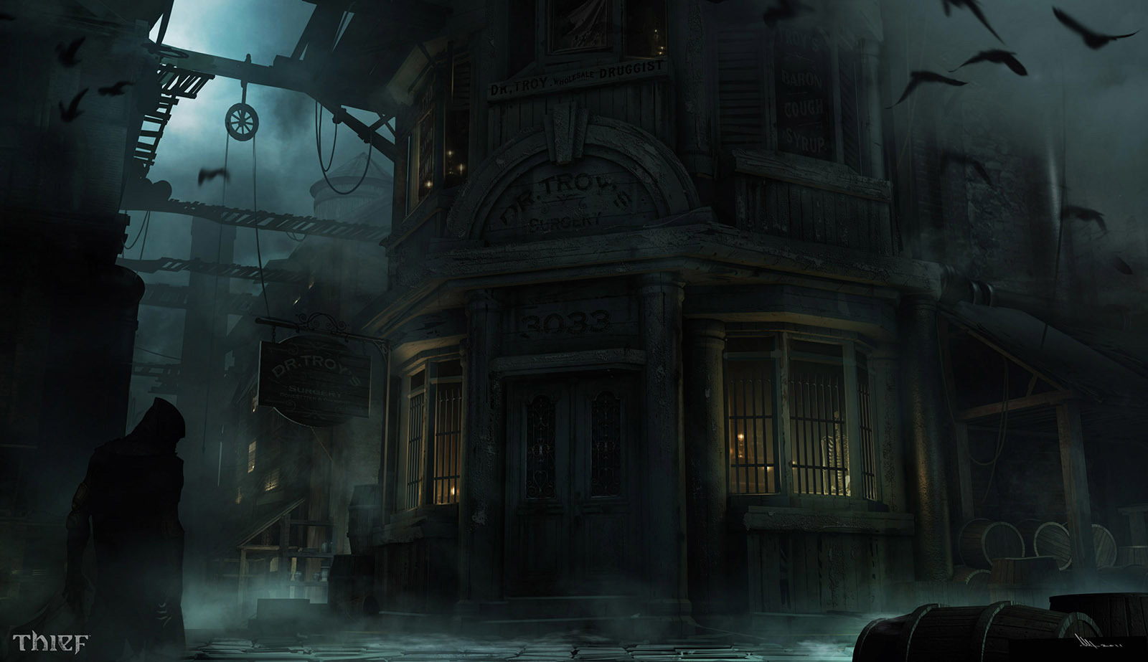

Creating a Game Design Document
Art and Video Style
Define the palette for your game. Concept art can be a useful springboard here, lending to the feel and tone of the game. Agreement between the Lead Artist, Designer and Producer is important.
Concept art for Thief 4 by Mathieu Latour-Duhaime. The game has a dark and foreboding palette, punctuated by points of light.

Slide 26

Mood Board
Any images used will need to be referenced

Slide 27
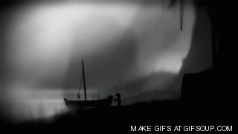
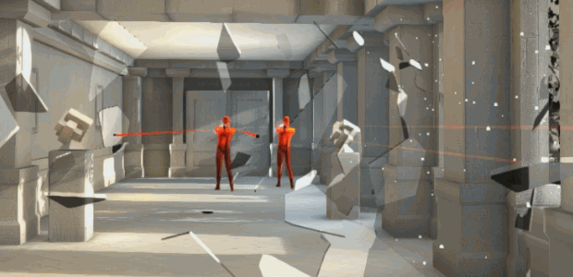
Mono-chrome
Black and white gradient tones
with highlights from strong primary
colours.
It can be used to great effect if key parts of the game are shaded with bright colours as contrast.
Sets the mood/atmosphere for the game world.

Slide 28
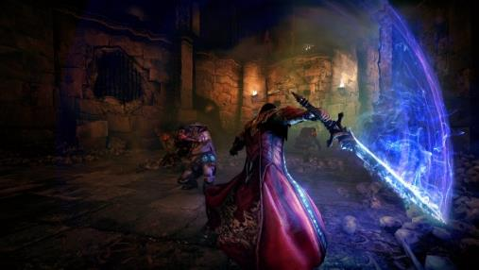
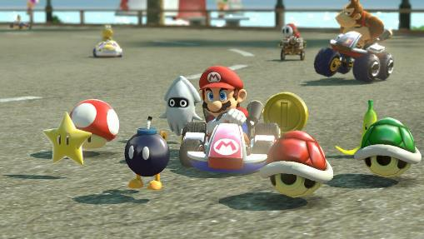
How to use visual styles effectively
The visual style should compliment the theme of game.
To make best use of colours in any game it is important to keep specific colours for specific tasks.

Slide 29
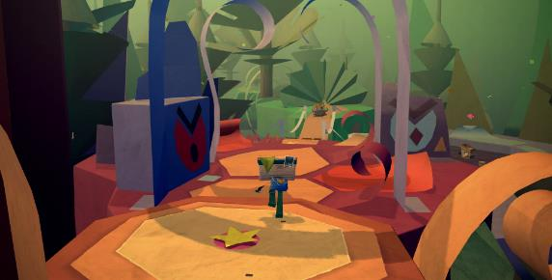
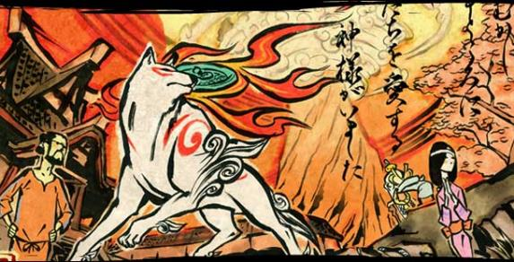
More General ‘Themes’
A particular art style
A material
Traditional Game Themes

Slide 30
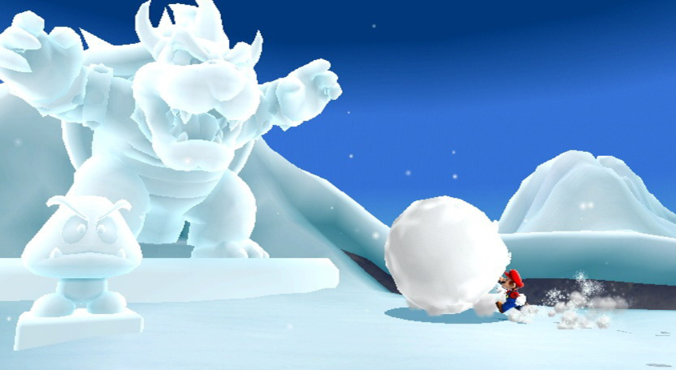
Ice Theme

Slide 31
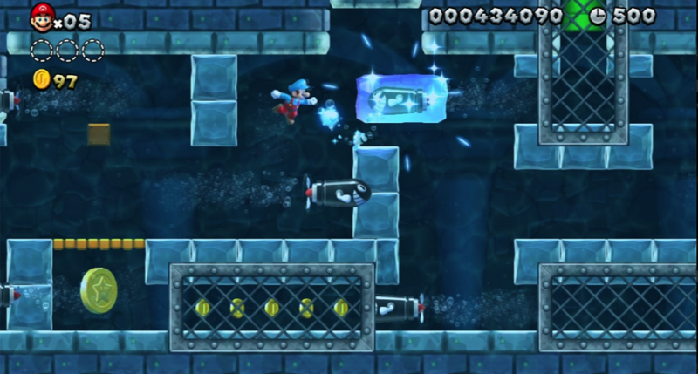
Water Theme

Slide 32
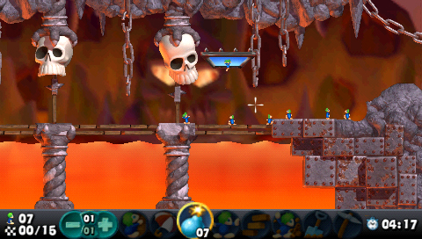
Fire Theme

Slide 33
Let’s try and be
Just a little More Imaginative!
This might also link up to your procedural generation.
Produce the same world but with a different visual theme!

Slide 34
Creating a Game Design Document
Art and Video Style
List all art assets needed in the game. This can include…
Character Design (including costumes and animations)
Game Object art: Pick-ups, switches, weapons… Describe how they animate.
Environment art: Tiles, scenery elements, terrain, sky, background art.
Special effects: Explosions, lighting effects, environmental effects (fog, rain, tire tracks, bullet marks, debris)
GUI art: Splash screens and type design
Design and storyboarding of any cut-scenes and cinematics – video assets needed throughout the game.
Promotional art: Online assets, logos…
It is important to ensure that everyone on your team knows who is responsible for what, so this can provide a useful reference for the team.

Slide 35
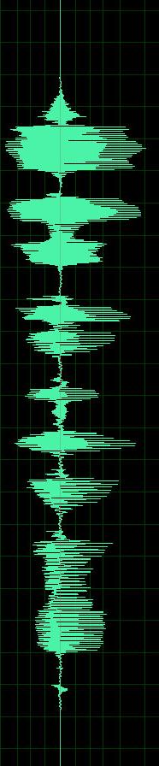

Audio – Uses and theme
Things to think about:
The game needs both background music and sound effects to be implemented.
These should fit with the theme of the game.
Sound effects should provide feedback to the player.
You are assessed on how effectively you use them, NOT their quality.
In the GDD:
Overall theme and style of the audio
When & How will sound be used?
How will it convey the information the play requires?
Audio equivalent of a Mood Board
Mix tape?

Slide 36
Creating a Game Design Document
Audio
List all audio assets used in the game. This can include…
Character effects: Voice recordings for important NPCs, background voices, effects and general ambience. Character interaction with the environment – walking, running, landing, picking up and dropping objects)
Environmental effects: Wind, rain, running water, foliage and trees, falling rocks. Be clear in your design what is a constant sound, what is triggered randomly, and what is triggered by actions.
Note: Games like Phasmophobia by Kinetic Games have particularly good sound design. Larger maps will have odd creaks and bangs that add to the atmosphere of being inside a large abandoned building but are very different from the sounds that will be created by the ghost. The player is not likely to confuse them.
Special effects: Weapons being fired, swords clashing, spells being cast…
GUI sound effects – It is important to relay to the player that the option they have selected has been actioned.

Slide 37
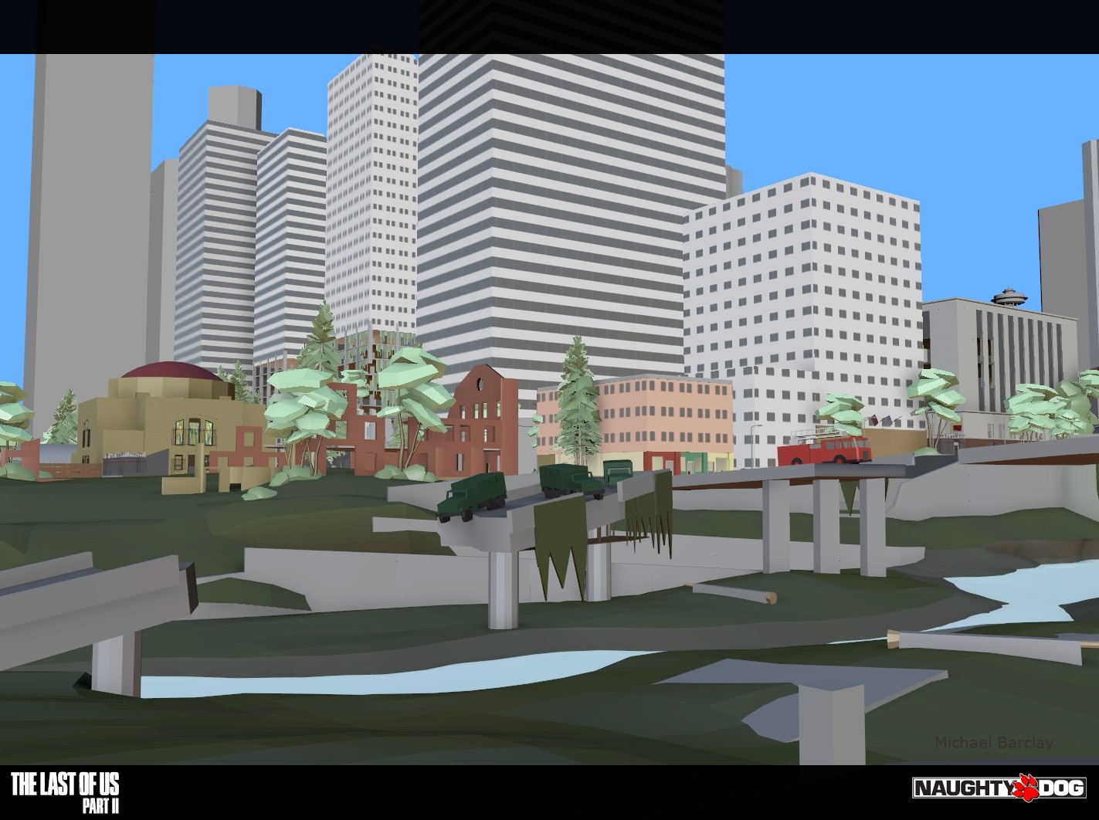
Creating a Game Design Document
Level Design
The Level Design section can include:
A map, diagram, or flowchart outlining how the levels are connected, and what conditions need to be in place for the player to progress to the next level. Is the player locked off completely? Do success and failure result in different paths? A table can be drawn up outlining progress and initial level conditions.
Initial level design concepts. Does not need to be a fully designed level and will likely evolve through implementation and play-testing. This section can include guidelines for level creation – features that fit the lore of the game, specific design requirements around puzzles and set-piece challenges.
Block-out of Seattle from The Last of Us Part 2 – Naughty Dog

Slide 38
Creating a Game Design Document
Level Design
A Beat Chart can be a useful tool for keeping track of what is needed when (and where) in your game. Also, what the player is doing and where new items or abilities may be unlocked.
This can also be expressed as a Gannt chart, to track where in the level events occur.
Level Dynamics Identify where elements of the level change and describe how it links to progression, if relevant – Moving platforms, destructible scenery. Also, correlation to your asset list – If the player needs to blow a hole in a wall, do they have the dynamite at that point? If not, can they still progress?
Game Element | Helgen
Location | Courtyard | Tower | Inn/Courtyard | Keep
Gameplay | Running | Running, jumping | Running | Running, fighting, blocking, looting
Objective | Escape Alduin | Escape Alduin | Escape Alduin | Escape Helgen
Story beat | Alduin attacks Helgen | Make way to Keep | Make way to Keep | Explore Keep
New weapon | None (Hands Bound) | None (Hands Bound) | None (Hands Bound) | Iron War Axe, Imperial Sword, Iron Dagger
Enemies | Alduin | Alduin | None | Imperials
Mechanics | Fire | Fire, falling rubble | Chasm | Attacking NPCs
NPC | Hadvar, Ralof | Hadvar, Ralof | Hadvar, Ralof | Ralof, Imperials
An Example Beat Chart of the opening ‘Helgen’ Tutorial from Elder Scrolls V: Skyrim

Slide 39
Creating a Game Design Document
Some general thoughts and guidelines:
The design must clearly identify what the core features of the game must be in order to satisfy the core pillars of the underlying concept.
You can use MoSCoW as a guide to help prioritise features: Must have, Should have, Could have, Won’t have. It helps to cement your concept and avoid ‘Feature Creep’.
Avoid duplication, vagueness and ambiguity. As you work on the live documentation, you will be populating both the GDD and the TDD. Use the structure templates provided to help you choose what needs to go where. For example, a GDD might have:
‘The boss character for Level 1 has three principle attributes: energy, shield strength, and firepower’.
Whereas your TDD might have:
‘The boss character from Level 1 is an instance of the Boss class, which inherits from the NPC class and has the following additional attributes: float energy; float shieldStrength; float firePower;’.
Take your time creating the document – The length of the document is not necessarily proportional to the time taken to create the design. Ensure you have time to reflect and make changes where necessary.
The GDD does not refer to the real-world actions performed by the player, but the in-game actions performed by the player-character via the player.
‘At the very edge of the ledge, the player jumps to get across the chasm.’
Not, ‘At the very edge of the ledge, the player presses the jump key or “A” on the controller to get across the chasm.’

Slide 40
Creating a Game Design Document
Some general thoughts and guidelines:
If your Design document follows a clear structure, you can then use those details as a springboard for the Technical documentation, and the dev team can easily see what needs to be done…
Details about characters, in-game elements and behaviours can then map to the implementation/ coding details as well as data structures used in the TDD.
Character designs and abilities can serve as a guide for the artists and animators.
Maps and level design provide a basis for level creation and scripting.
Sound effects musical requirements serve as a guide for the composers/ sound engineers.
In-game features, flow/ progression, also provide a framework for QA and testing.
Hint: Once you know what your Core Mechanics are, make a plan to prioritise and test them. How will you know they work the way you want/need them to?

Slide 41
Creating a Game Design Document
Some general thoughts and guidelines:
It can facilitate the game development process if the stages of the design document are ‘concept aligned’. This means that the concept documentation (Pitch/ 1-Page, 10-Page) spells out the core pillars of the game. These pillars then map to the GDD as outlined above. In turn the GDD maps to the TDD and the production/ schedule documentation. All elements can be seen to map to those core pillars of the game. Producing a map of how your documentation aligns can be helpful to eliminate duplication and avoid ambiguity.
Technical Specification
Game Design
Concept / Pillars / USPs
Gameplay / Flow
Production Schedules

Slide 42
Creating a Game Design Document
Some general thoughts and guidelines:
Leave room to manoeuvre. The design is open to, and liable to, change through regular team meetings.
It may change during development.
All changes must be reflected through the documentation! Communication within the team is crucial here. When you meet, take notes. Appoint someone to take minutes of the meeting to keep track of what was discussed and who was present.
Development/ Prototyping
Testing
Changes get fed-back through the technical specification documentation.
This in turn can feed back to the game design document, which in turn can result in revised schedules.
More critical changes often require the concept be re-written so new schedules can be derived and approved.
Review / Design Eval

Slide 43
References / Resources
• Developing a Game Design Document
https://www.gamasutra.com/view/feature/131632/creating_a_great_design_document.php
• The anatomy of a game design document – Part 1
https://www.gamasutra.com/view/feature/131791/the_anatomy_of_a_design_document_.php
• The anatomy of a game design document – Part 2
https://www.gamasutra.com/view/feature/131818/the_anatomy_of_a_design_document_.php
• From Games to Change (Psychological viewpoint of Serious Games)
https://www.slideshare.net/MavisDixon/from-games-to-change-full-indie-presentation-aug-9-2014
• The Psychology of Flow (also see Mihaly Csikszentmihalyi )
https://en.m.wikipedia.org/wiki/Flow_(psychology)

